Slide 1

Advanced Polymorphism
Many Forms

Slide 2
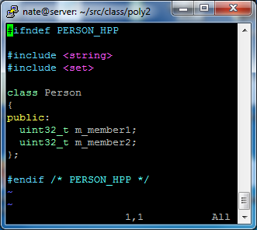
Deep Dive into Simple Inheritance
How big is this object?
What are the addresses of each member?
How did the compiler lay out the members?
Start with a simple version of our Person object

Slide 3
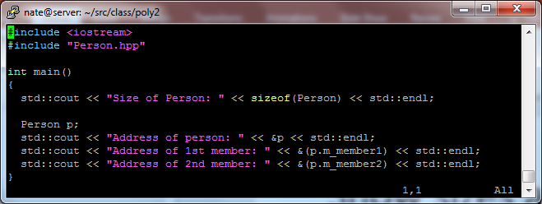
Show sizes and addresses of members
Let’s code this up and see what we get
Any guesses before we implement?

Slide 4
How Does C/C++ Lay Out Structures/Classes
Assume this is our “Person” object with some arbitrary members
== &person + 0
uint32_t m_mem1
Compilers have much leeway here; standards are loose
PAD
uint64_t m_mem2
== &person + 8
== &person + 16
uint32_t m_mem3
== &person + 20
uint16_t m_mem4

Slide 5
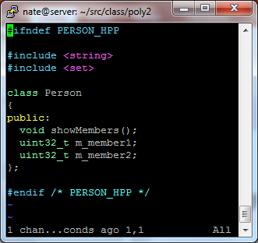
How Does Method Inclusion Change Size?
Same questions as before
What if we have multiple methods?
//TRICKY: note that the method is a standard method
Now we have a method…

Slide 6
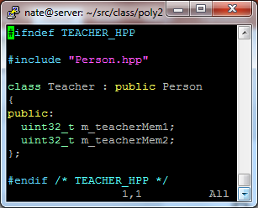
Back to Inheritance
Teacher “is a” Person
How big is this object?
What are the addresses of each member?
How did the compiler lay out the members?

Slide 7
Derived Class Members are “tacked on”
Assume this is now our “Teacher” object
== &person + 0
uint32_t m_mem1
PAD
Person
uint64_t m_mem2
== &person + 8
== &person + 16
uint32_t m_mem3
Teacher
== &person + 20
uint16_t m_mem4

Slide 8
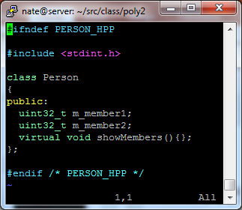
Remember that “Tricky” note?
We have added exactly one word to the Person header
How big is this object?
What are the addresses of each member?
What the heck is going on?
What if we add many virtual methods?

Slide 9
How Does C/C++ Lay Out Structures/Classes with Virtual Methods
void *vtable
== &person + 0
== &person + 8
uint32_t m_mem1
Here is a “member” we never declared
PAD
uint64_t m_mem2
== &person + 16
== &person + 24
uint32_t m_mem3
== &person + 28
uint16_t m_mem4

Slide 10
How Does C/C++ Lay Out Structures/Classes with Virtual Methods
void *vtable
void func1()
{
}
uint32_t m_mem1
Ptr to func1
PAD
Ptr to func2
void func2()
{
}
uint64_t m_mem2
uint32_t m_mem3
uint16_t m_mem4

Slide 11
Each “class” (not instance) has a vtable
Example of Teacher overriding func1, but not func2
void Person::func1()
{
}
Teacher t1
void *vtable
Person p1
TeacherVTable
PersonVTable
void *vtable
Teacher t2
void Teacher::func1()
{
}
Ptr to func1
Ptr to func1
void *vtable
Ptr to func2
Person p2
Ptr to func2
void *vtable
Teacher t3
void Person::func2()
{
}
void *vtable

Slide 12
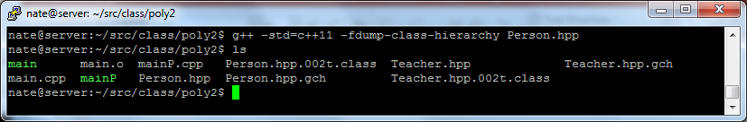
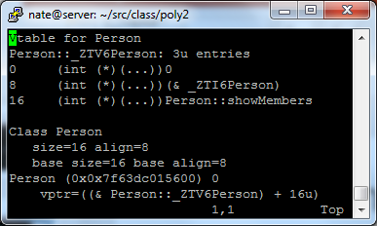
What Can the Compiler Tell Us About the vtable?

Slide 13
How Does Multiple Inheritance Work?
Let’s model an all-in-one printer/scanner device
== &allInOne + 0
uint32_t m_mem1
Scanner
== &allInOne + 4
uint32_t m_mem2
uint64_t m_mem3
== &allInOne + 8
Printer
== &allInOne + 16
uint32_t m_mem4
AllInOne
== &allInOne + 20
uint16_t m_mem5

Slide 14
Multiple Inheritance Discussion Questions:
Can we pass an AllInOne object into a function accepting a Printer as an argument?
Can we pass an AllInOne object into a function accepting a Scanner as an argument?
Suppose we build three functions, one that takes a ref to a Scanner, Printer, and an AllInOne. If we print the address of the parameter, what will the value be? Why?
Code it and prove/disprove your conjecture

Slide 15
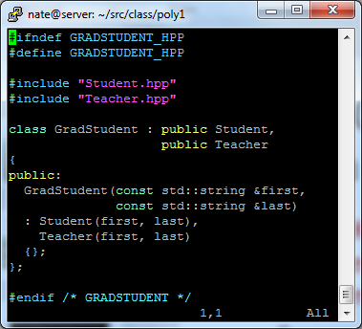
Let’s Code – Can Someone Be Both a Student and a Teacher?
Remember that both of these inherit from Person
//TRICKY: This is nuanced (Diamond Problem)
Can someone describe the memory layout for this object?

Slide 16
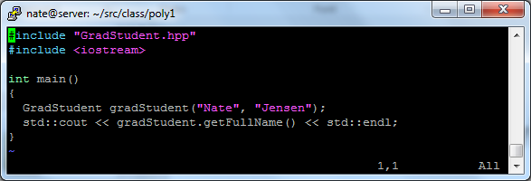
What’s wrong with this code?
Sure looks good, but it won’t compile
How many times did we inherit from Person?

Slide 17
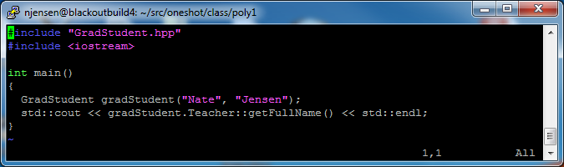
What’s wrong with this code?
Now it compiles… but still totally broken
How many first names does a grad student really have?
How many times did we inherit from Person?

Slide 18
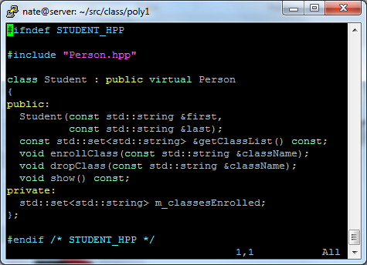
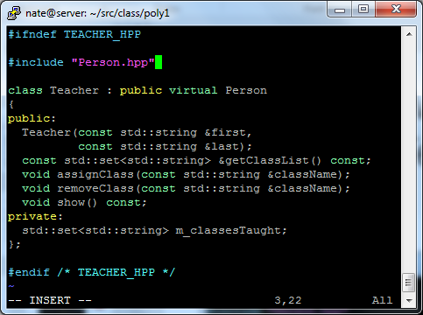
Is There a Way to Make GradStudent (Student/Teacher) Share the Same Person
Use a pointer to base class rather than containment

